Slide 1
LESSON 28

Slide 2
Overview
of
Previous Lesson(s)

Slide 3
Over View
In syntax-directed translation we construct a parse tree or a syntax tree, and then to compute the values of attributes at the nodes of the tree by visiting the nodes of the tree.
Syntax-directed translations called L-attributed translations which encompass virtually all translations that can be performed during parsing.
S-attributed translations can be performed in connection with a bottom-up parse.
A syntax-directed definition (SDD) is a context-free grammar together with attributes and rules.

Slide 4
Over View..
A dependency graph depicts the flow of information among the attribute instances in a particular parse tree.
An edge from one attribute instance to another means that the value of the first is needed to compute the second.
Edges express constraints implied by the semantic rules.
The dependency graph characterizes the possible orders in which we can evaluate the attributes at the various nodes of a parse tree.

Slide 5
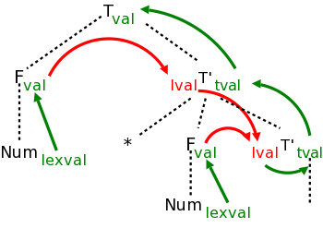
Over View…
The black dotted lines comprise the parse tree for the multiplication grammar just studied when applied to a single multiplication, e.g. 3*5.
Each synthesized attribute is shown in green and is written to the right of the grammar symbol at the node where it is defined.
Each inherited attribute is shown in red and is written to the left of the grammar symbol where it is defined.

Slide 6
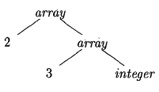
Over View…
Inherited attributes are useful when the structure of the parse tree differs from the abstract syntax of the input.
Attributes can then be used to carry information from one part of the parse tree to another.
Ex. In C, the type int[2][3] can be read as, array of 2 arrays of 3 integers
If types are represented by trees, then this operator returns a tree node labeled array with two children for a number and a type.

Slide 7
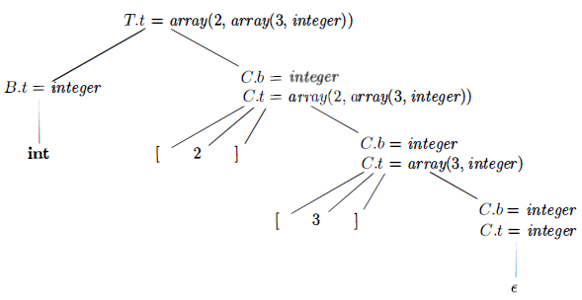
Over View…
An annotated parse tree for the input string int[2][3]
The array type is synthesized up the chain of C's through the attributes t
At the root for T → B C non-terminal C inherits the type from B using the inherited attribute C.b
At the rightmost node for C the production is C → ɛ so C.t equals C.b
The semantic rules for the production C → [num] C₁ form C.t by applying the operator array to the operands num.val and C₁.t

Slide 8
Over View…
The simplest SDD implementation occurs when we can parse the grammar bottom-up and the SDD is S-attributed.
SDT's with all actions at the right ends of the production bodies are called postfix SDT's.
Postfix SDT's can be implemented during LR parsing by executing the actions when reductions occur.

Slide 9
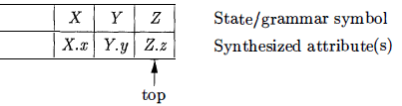
Over View…
The parser stack contains records with a field for a grammar symbol & a field for an attribute.
If the attributes are all synthesized, and the actions occur at the ends of the productions, then we can compute the attributes for the head when we reduce the body to the head.
If we reduce by a production such as A -t X Y Z, then we have all the attributes of X, Y, and Z available, at known positions on the stack
After the action, A and its attributes are at the top of the stack, in the position of the record for X .

Slide 10
Over View…
An action may be placed at any position within the body of a production. It is performed immediately after all symbols to its left are processed.
For a production B → X {a} Y the action a is done after we have recognized X (if X is a terminal) or all the terminals derived from X (if X is a non-terminal).
Ex: Turn desk-calculator into an SDT that prints the prefix form of an expression, rather than evaluating the expression.

Slide 11
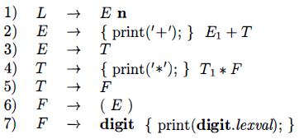
Over View…
SDT for infix-to-prefix translation during parsing
It is impossible to implement this SDT during either top-down or bottom-up parsing.
The parser would have to perform critical actions, like printing instances of * or +, long before it knows whether these symbols will appear in its input.

Slide 12
Over View…
Any SDT can be implemented as follows:
Ignoring the actions, parse the input and produce a parse tree as a result.
Then, examine each interior node N, say one for production B → α Add additional children to N for the actions in α so the children of N from left to right have exactly the symbols and actions of α
Perform a preorder traversal of the tree, and as soon as a node labeled by an action is visited, perform that action.

Slide 13
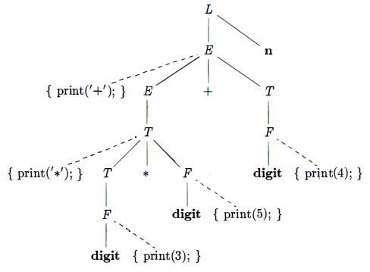
Over View…
It shows the parse tree for expression 3 * 5 + 4 with actions inserted.
Visiting the nodes in preorder, we get the prefix form of the expression: + * 3 5 4.

Slide 14
Over View…
No grammar with left recursion can be parsed deterministically top-down.
When transforming the grammar, treat the actions as if they were terminal symbols.
This principle is based on the idea that the grammar transformation preserves the order of the terminals in the generated string.
The actions are executed in the same order in any left-to-right parse, top-down or bottom-up.

Slide 15
Over View…
The "trick" for eliminating left recursion is to take two productions A → A α | β
It generate strings consisting of a β and any number of α‘s & replace them by productions that generate the same strings using a new non-terminal R of the first production:
A → β R
R → α β | ɛ
If β does not begin with A, then A no longer has a left-recursive production.
In regular-definition, with both sets of productions, A is defined by β(α)*

Slide 16
Over View…
A parse tree is called a concrete syntax tree
An abstract syntax tree (AST) is defined by the compiler writer as a more convenient intermediate representation
E
+
E
+
T
id
*
T
T
*
id
id
id
id
id
Concrete syntax tree
Abstract syntax tree

Slide 17
Contents
SDT's With Actions Inside Productions
Eliminating Left Recursion From SDT's
SDT's for L-Attributed Definitions
Intermediate-Code Generation
Variants of Syntax Trees
Directed Acyclic Graphs for Expressions
The Value-Number Method for Constructing DAG's
Three-Address Code
Addresses and Instructions
Quadruples
Triples
Static Single-Assignment Form

Slide 18
SDT’s for L-Attributed Definitions
First we assume that the underlying grammar can be parsed top-down. Rules for turning an L-attributed SDD into an SDT:
Embed the action that computes the inherited attributes for a non-terminal A immediately before that occurrence of A in the body of the production. If several inherited attributes for A depend on one another in an acyclic fashion, order the evaluation of attributes so that those needed first are computed first.
Place the actions that compute a synthesized attribute for the head of a production at the end of the body of that production.

Slide 19
SDT’s for L-Attributed Definitions..
We shall illustrate these principle with an extended example.
This is about the generation of intermediate code for a typical programming-language construct: a form of while-statement.
S → while ( C ) S₁
S is the non-terminal that generates all kinds of statements, presumably including if-statements, assignment statements, and others.
C stands for a conditional expression - a Boolean expression that evaluates to true or false.
The meaning of our while-statement is that the conditional C is evaluated.
If true, control goes to the beginning of the code for S₁
If false, then control goes to the code that follows the while-statement's code.

Slide 20
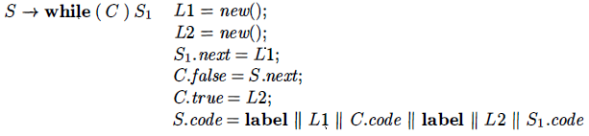
SDT’s for L-Attributed Definitions…
We use the following attributes to generate the proper intermediate code:
Following attributes are used to generate the proper intermediate code:
The inherited attribute S.next labels the beginning of the code that must be executed after S is finished.
The synthesized attribute S.code is the sequence of intermediate-code steps that implements a statement S and ends with a jump to S.next.
The inherited attribute C.true labels the beginning of the code that must be executed if C is true.

Slide 21
SDT’s for L-Attributed Definitions…
The inherited attribute C.false labels the beginning of the code that must be executed if C is false.
The synthesized attribute C. code is the sequence of intermediate-code steps that implements the condition C and jumps either to C.true or to C.false depending on whether C is true or false.
The function new generates new labels.
The variables L1 and L2 hold labels that we need in the code.
L1 is the beginning of the code for the while-statement, and we need to arrange that S1 jumps there after it finishes.

Slide 22
SDT’s for L-Attributed Definitions…
That is why we set S₁.next to L₁ . L₂ is the beginning of the code for
S1, and it becomes the value of C. true, because we branch there when C is true .
C.false is set to S. next, because when the condition is false, we execute whatever code must follow the code for 8
We use ǁ as the symbol for concatenation of intermediate-code fragments.
The value of S. code thus begins with the label L₁, then the code for condition C, another label L₂, and the code for S₁ .

Slide 23

SDT’s for L-Attributed Definitions…
This SDD is L-attributed. When we convert it into an SDT, the only remaining issue is how to handle the labels L₁ & L₂, which are variables, and not attributes.
Treat actions as dummy non-terminals, then such variables can be treated as the synthesized attributes of dummy non-terminals.
L₁ and L₂ do not depend on any other attributes, they can be assigned to the first action in the production.
SDT with embedded actions that implements this L-attributed definition

Slide 24
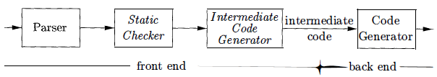
Intermediate Code Generation
Facilitates retargeting: enables attaching a back end for the new machine to an existing front end.
In the analysis-synthesis model of a compiler, the front end analyzes a source program and creates an intermediate representation, from which the backend generates target code.

Slide 25
DAG for Expressions
Nodes in a syntax tree represent constructs in the source program, the children of a node represent the meaningful components of a construct.
A directed acyclic graph (DAG) for an expression identifies the common sub-expressions of the expression.
It has leaves corresponding to atomic operands and interior codes corresponding to operators.

Slide 26
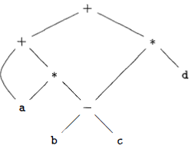
DAG for Expressions..
A node N in a DAG has more than one parent if N represents a common Sub-expression.
In a syntax tree, the tree for the common sub expression would be replicated as many times as the sub expression appears in the original expression.
Ex. a + a * (b - c) + (b - c) * d
The leaf for a has two parents, because a appears twice in the expression.

Slide 27
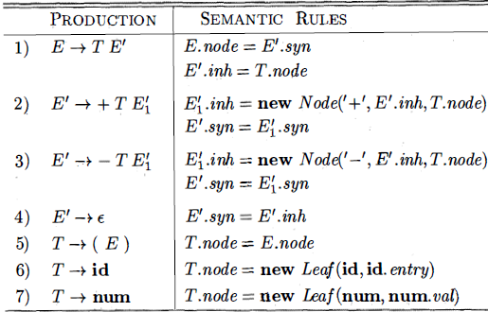
DAG for Expressions..
Syntax trees or DAG’s can be constructed by this SDD
Functions Leaf and Node created a fresh node each time they were called.
It will construct a DAG if, before creating a new node these functions first check whether an identical node already exists.
If a previously created identical node exists, the existing node is returned.

Slide 28
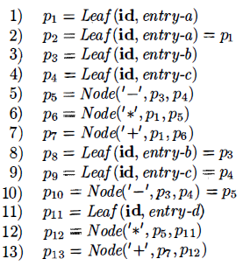
DAG for Expressions…
Steps for constructing the DAG

Slide 29
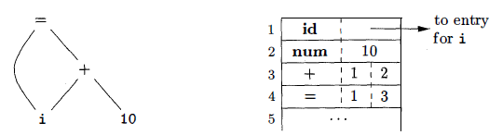
Value-Number Method for Constructing DAG's
The nodes of a syntax tree or DAG are stored in an array of records
DAG for i = i + 10 allocated in an array
Each row of the array represents one record, and therefore one node.
In each record, the first field is an operation code, indicating the label of the node.
In array, leaves have one additional field, which holds the lexical value and interior nodes have two additional fields indicating the left and right children.

Slide 30
Three Address Code
In three-address code, there is at most one operator on the right side of an instruction.
A source-language expression like x+y*z might be translated into the sequence of three-address instructions.
t₁ = y * z
t₂ = x + t₁
t₁ and t₂ are compiler-generated temporary names.

Slide 31
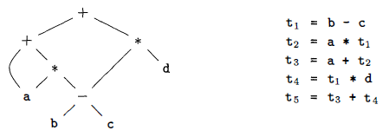
Three Address Code
Three-address code is a linearized representation of a syntax tree or a DAG in which explicit names correspond to the interior nodes of the graph.

Slide 32
Addresses and Instructions
Three-address code is built from two concepts: addresses and instructions.
In object-oriented terms, these concepts correspond to classes, and the various kinds of addresses and instructions correspond to appropriate subclasses.
Alternatively, three-address code can be implemented using records with fields for the addresses.
These records are called quadruples and triples.

Slide 33
Addresses and Instructions..
An address can be one of the following:
Name For convenience, we allow source-program names to appear as addresses in three-address code. In an implementation, a source name is replaced by a pointer to its symbol-table entry, where all information about the name is kept.
Constant In practice, a compiler must deal with many different types of constants and variables.
Compiler-generated temporary. It is useful, especially in optimizing compilers, to create a distinct name each time a temporary is needed.

Slide 34
Addresses and Instructions...
A list of the common three-address instruction forms:
Assignment instructions of the form x = y op Z, where op is a binary arithmetic or logical operation, and x, y, and z are addresses.
Assignments of the form x = op y where op is a unary operation.
Copy instructions of the form x = y, where x is assigned the value of y.
An unconditional jump goto L. The three-address instruction with label L is the next to be executed.

Slide 35
Addresses and Instructions...
Conditional jumps of the form if x goto L and if False x got o L.
Conditional jumps such as if x relop y goto L which apply a relational operator <<, ==, >= to x & y and execute the instruction with label L next if x stands in relation relop to y.
Indexed copy instructions of the form x = y[i] and x[i] = y
Address and pointer assignments of the form x = &y x =* y and *x = y

Slide 36
Quadruples
A quadruple has four fields, known as op, arg₁, arg₂ & result
The op field contains an internal code for the operator.
For instance, the three-address instruction x = y + Z is represented by placing + in op y in arg₁ z in arg₂ and x in result
Some exceptions to this rule:
Instructions with unary operators like x = minus y or x = y do not use arg₂
Operators like param use neither arg₂ nor result.
Conditional and unconditional jumps put the target label in result.

Slide 37
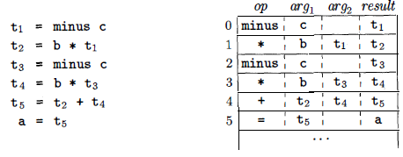
Quadruples..
Ex: Three-address code for the assignment a = b* - c + b* - c ;
Three Address Code Quadruples

Slide 38
Triples
A triple has only three fields, which we call op, arg1 , and arg2.
DAG and triple representations of expressions are equivalent.
The result of an operation is referred to by its position.
A benefit of quadruples over triples can be seen in an optimizing compiler, where instructions are often moved around.
With quadruples, if we move an instruction that computes a temporary t, then the instructions that use t require no change.
With triples, the result of an operation is referred to by its position, so moving an instruction may require us to change all references to that result .

Slide 39
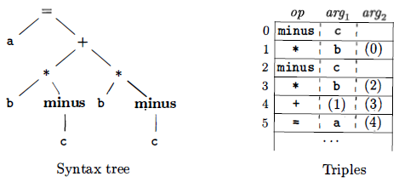
Triples..
Ex: Representations of a + a * (b - c) + (b - c) * d
A ternary operation like x [i] = y requires two entries in the triple structure.
for ex, we can put x and i in one triple and y in the next.

Slide 40
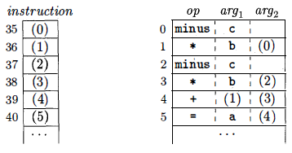
Triples..
Indirect triples consist of a listing of pointers to triples, rather than a listing of triples themselves.
With indirect triples, an optimizing compiler can move an instruction by reordering the instruction list, without affecting the triples themselves.

Slide 41
Thank You

